Slide 1
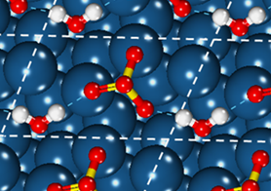
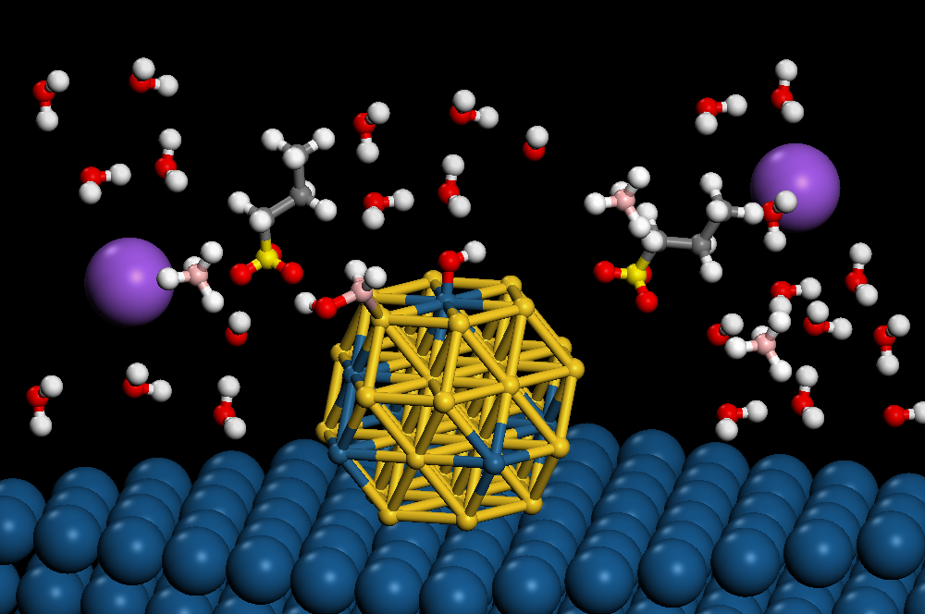
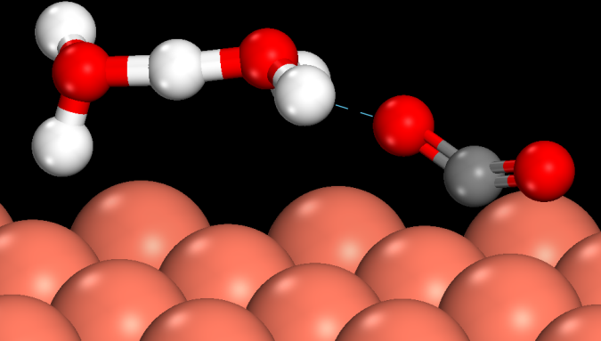
Electronic structure modeling of electrocatalysis at the electrode-electrolyte interface
Michael J. Janik
Professor of Chemical Engineering
Pennsylvania State University mjanik@psu.edu
Mississippi State University – iCOMSE Workshop
June 16, 2022
Notes:
Simple and approximate method to calculate barriers for coupled ion/electron transfer reactions in electrocatalytic system

Slide 2
A general electrochemical cell has an anode, cathode, and electrolyte
e⁻
Power Supply or Demand
e⁻
Anode – oxidation
Cathode – reduction
anode
cathode
B+
ionic
transport
A
Electrochemical Potential (U or V)
Energy per Charge
Varies with position in cell
Cell potential: U_{cathode}-U_{anode}
Notes:
A basic electrochemical system consists of two electrodes and an electrolyte. An electrode is electron conducting, and interchange of electrons with species in the electrolyte occurs at its surface. An electrolyte is ion conducting. Anode – cathode. The electrochemical potential is the energy per charge, and varies with position in the cell. As any energy measurement, it must be referenced, so that we can talk of potential differences between an electron in the anode versus the cathode, versus a position in solution, or versus some reference we invoke. As a point of reference for surface scientists, if we referenced the potential to the energy of an electron isolated in vacuum, then the potential of a metal electrode would be equivalent to the work function of the surface. An attached power supply, or simply the passing of charge between the two connected electrodes, may alter the charge on the electrode surface from that of a neutral system.

Slide 3
What are electrochemical devices/technologies used for?
Notes:
A basic electrochemical system consists of two electrodes and an electrolyte. An electrode is electron conducting, and interchange of electrons with species in the electrolyte occurs at its surface. An electrolyte is ion conducting. Anode – cathode. The electrochemical potential is the energy per charge, and varies with position in the cell. As any energy measurement, it must be referenced, so that we can talk of potential differences between an electron in the anode versus the cathode, versus a position in solution, or versus some reference we invoke. As a point of reference for surface scientists, if we referenced the potential to the energy of an electron isolated in vacuum, then the potential of a metal electrode would be equivalent to the work function of the surface. An attached power supply, or simply the passing of charge between the two connected electrodes, may alter the charge on the electrode surface from that of a neutral system.

Slide 4
What are electrochemical devices/technologies currently used for?
Batteries – portable power (alkaline, lead-acid, lithium ion)
Fuel cells – some portable power applications (auxiliary in trucks, forklifts)
Chlor alkali process
electrolysis of water for hydrogen generation
Electroplating – coating metals onto objects (jewelry, car paints)
sensors – redox of ethanol for drunk drivers, glucose measures for diabetes
(and electroanalytic processes in general widely used)
refining – pulling metals out of ores
Photosynthesis, corrosion, supercapacitors, action potentials in neurons, organic electronics, ….
Notes:
A basic electrochemical system consists of two electrodes and an electrolyte. An electrode is electron conducting, and interchange of electrons with species in the electrolyte occurs at its surface. An electrolyte is ion conducting. Anode – cathode. The electrochemical potential is the energy per charge, and varies with position in the cell. As any energy measurement, it must be referenced, so that we can talk of potential differences between an electron in the anode versus the cathode, versus a position in solution, or versus some reference we invoke. As a point of reference for surface scientists, if we referenced the potential to the energy of an electron isolated in vacuum, then the potential of a metal electrode would be equivalent to the work function of the surface. An attached power supply, or simply the passing of charge between the two connected electrodes, may alter the charge on the electrode surface from that of a neutral system.

Slide 5
We learned how to use DFT to calculate the reaction energy (ΔE_{ads}) of
½ H_{2,gas} + surface → H-adsorbed to surface
DFT calculations we had to run:
H₂ in the gas phase (E_{H2})
surface without H adsorbed (E*)
surface with H adsorbed (E_{H*})
ΔE_{ads} = E_{H*} - E* - ½ E_{H2}
Notes:
A basic electrochemical system consists of two electrodes and an electrolyte. An electrode is electron conducting, and interchange of electrons with species in the electrolyte occurs at its surface. An electrolyte is ion conducting. Anode – cathode. The electrochemical potential is the energy per charge, and varies with position in the cell. As any energy measurement, it must be referenced, so that we can talk of potential differences between an electron in the anode versus the cathode, versus a position in solution, or versus some reference we invoke. As a point of reference for surface scientists, if we referenced the potential to the energy of an electron isolated in vacuum, then the potential of a metal electrode would be equivalent to the work function of the surface. An attached power supply, or simply the passing of charge between the two connected electrodes, may alter the charge on the electrode surface from that of a neutral system.

Slide 6
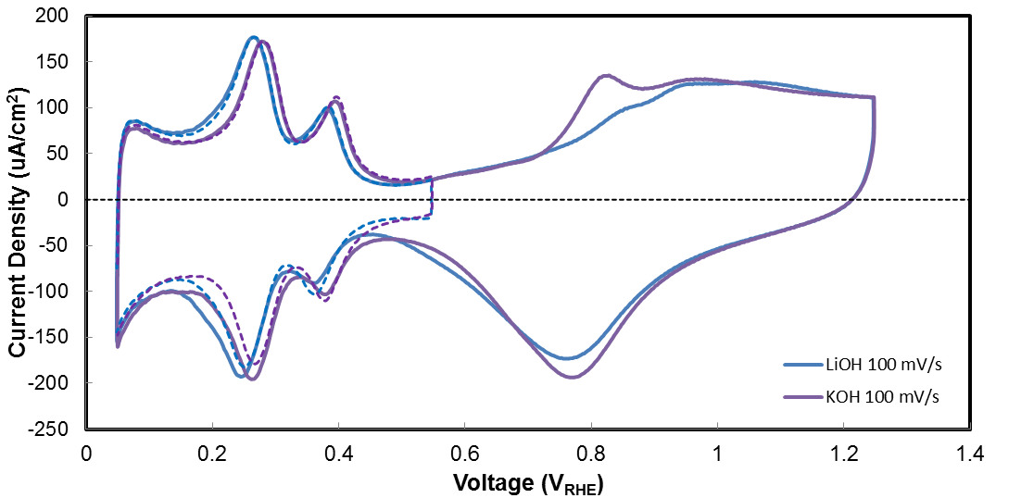
Experimental cyclic voltammogram examines H/OH adsorption/desorption from Pt surfaces
Cyclic voltammetry of a polycrystalline platinum electrode
“H region”
O/OH/PtO_{x} region
Pt(110)
Pt(100)
Pt(111) [broad]
H* → H⁺ + e⁻ + *
H⁺ + e⁻ + * → H*

Slide 7
We learned how to use DFT to calculate the reaction energy (ΔE_{ads}) of
½ H_{2,gas} + * → H*
ΔE_{ads} = E_{H*} - E* - ½ E_{H2}
How do we calculate the reaction energy of:
H⁺_{aqueous}+ e⁻ + * → H*
Notes:
A basic electrochemical system consists of two electrodes and an electrolyte. An electrode is electron conducting, and interchange of electrons with species in the electrolyte occurs at its surface. An electrolyte is ion conducting. Anode – cathode. The electrochemical potential is the energy per charge, and varies with position in the cell. As any energy measurement, it must be referenced, so that we can talk of potential differences between an electron in the anode versus the cathode, versus a position in solution, or versus some reference we invoke. As a point of reference for surface scientists, if we referenced the potential to the energy of an electron isolated in vacuum, then the potential of a metal electrode would be equivalent to the work function of the surface. An attached power supply, or simply the passing of charge between the two connected electrodes, may alter the charge on the electrode surface from that of a neutral system.

Slide 8
We learned how to use DFT to calculate the reaction energy (ΔE_{ads}) of
½ H_{2,gas} + * → H*
ΔE_{ads} = E_{H*} - E* - ½ E_{H2}
How do we calculate the reaction energy of:
H⁺_{aqueous}+ e⁻ + * → H*
ΔE_{ads} = E_{H*} - E* - E_{H+}-E_{e}
But how do we calculate the energy of an aqueous proton and an electron with DFT?
Notes:
A basic electrochemical system consists of two electrodes and an electrolyte. An electrode is electron conducting, and interchange of electrons with species in the electrolyte occurs at its surface. An electrolyte is ion conducting. Anode – cathode. The electrochemical potential is the energy per charge, and varies with position in the cell. As any energy measurement, it must be referenced, so that we can talk of potential differences between an electron in the anode versus the cathode, versus a position in solution, or versus some reference we invoke. As a point of reference for surface scientists, if we referenced the potential to the energy of an electron isolated in vacuum, then the potential of a metal electrode would be equivalent to the work function of the surface. An attached power supply, or simply the passing of charge between the two connected electrodes, may alter the charge on the electrode surface from that of a neutral system.

Slide 9
H⁺_{aqueous}+ e⁻ + * → H*
ΔG_{ads} = G_{H*} - G* - G_{H+}-G_{e}
But how do we calculate the energy of an aqueous proton and an electron with DFT?
Choice 1) “Calculate with DFT” the (free) energy of a gas phase proton, look up an experimental ΔG_{solvation}. Make sure your code calls 0 energy for an electron = electron in vacuum.
ΔG_{ads}(U_{abs}) = G_{H*} - G* - G_{H+,gas}+ ΔG_{H+, solv}) +|e⁻|U_{abs}
Notes:
A basic electrochemical system consists of two electrodes and an electrolyte. An electrode is electron conducting, and interchange of electrons with species in the electrolyte occurs at its surface. An electrolyte is ion conducting. Anode – cathode. The electrochemical potential is the energy per charge, and varies with position in the cell. As any energy measurement, it must be referenced, so that we can talk of potential differences between an electron in the anode versus the cathode, versus a position in solution, or versus some reference we invoke. As a point of reference for surface scientists, if we referenced the potential to the energy of an electron isolated in vacuum, then the potential of a metal electrode would be equivalent to the work function of the surface. An attached power supply, or simply the passing of charge between the two connected electrodes, may alter the charge on the electrode surface from that of a neutral system.

Slide 10
H⁺_{aqueous}+ e⁻ + * → H*
ΔG_{ads} = G_{H*} - G* - G_{H+}-G_{e}
Choice 1)
ΔG_{ads}(U_{abs}) = G_{H*} - G* - G_{H+,gas}+ ΔG_{H+, solv}) +|e⁻|U_{abs}
U_{abs} = “potential” of an electron relative to an electron in vacuum. Sign convention – more negative = less stable electron
+|e⁻|U_{abs}→ charge times potential = energy of an electron.
Notes:
A basic electrochemical system consists of two electrodes and an electrolyte. An electrode is electron conducting, and interchange of electrons with species in the electrolyte occurs at its surface. An electrolyte is ion conducting. Anode – cathode. The electrochemical potential is the energy per charge, and varies with position in the cell. As any energy measurement, it must be referenced, so that we can talk of potential differences between an electron in the anode versus the cathode, versus a position in solution, or versus some reference we invoke. As a point of reference for surface scientists, if we referenced the potential to the energy of an electron isolated in vacuum, then the potential of a metal electrode would be equivalent to the work function of the surface. An attached power supply, or simply the passing of charge between the two connected electrodes, may alter the charge on the electrode surface from that of a neutral system.

Slide 11
H⁺_{aqueous}+ e⁻ + * → H*
ΔG_{ads} = G_{H*} - G* - G_{H+}-G_{e}
Choice 2)
At 0 V on a “hydrogen electrode scale”
H_{2,gas} --> 2H+ + 2e⁻ has a ΔG=0
G_{H+} + G_{e-} = ½ G_{H2,gas} at 0 V on a CHE scale
G_{H+} + G_{e-} = ½ G_{H2,gas} - |e⁻|U_{CHE} at any potential relative to the CHE scale
ΔG_{ads}(U_{CHE}) = G_{H*} - G* - ½ G_{H2,gas}+ +|e⁻|U_{CHE}
Notes:
A basic electrochemical system consists of two electrodes and an electrolyte. An electrode is electron conducting, and interchange of electrons with species in the electrolyte occurs at its surface. An electrolyte is ion conducting. Anode – cathode. The electrochemical potential is the energy per charge, and varies with position in the cell. As any energy measurement, it must be referenced, so that we can talk of potential differences between an electron in the anode versus the cathode, versus a position in solution, or versus some reference we invoke. As a point of reference for surface scientists, if we referenced the potential to the energy of an electron isolated in vacuum, then the potential of a metal electrode would be equivalent to the work function of the surface. An attached power supply, or simply the passing of charge between the two connected electrodes, may alter the charge on the electrode surface from that of a neutral system.

Slide 12
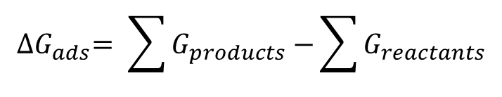
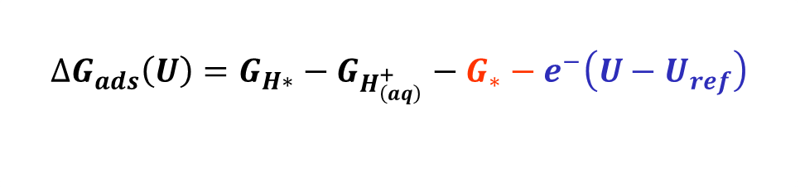
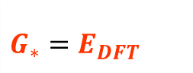
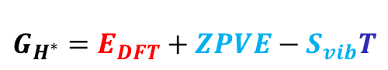
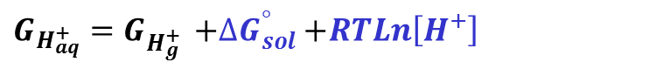
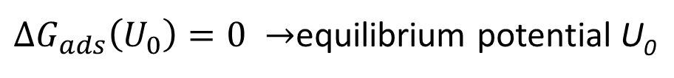
Ion adsorption free energies are calculated using a combination of DFT calculations, statistical mechanics, and experimental data
+
+
e⁻
+
$${∆G}_{ads}= \sum{G_{products}−}\sum{G_{reactants}}$$
DFT
$${∆G}_{ads}\left(U\right)=G_{H∗}−G_{H_{\left(aq\right)}^{+}}−G_{∗}−e^{−}\left(U−U_{ref}\right)$$
DFT_{VIB}
Stat Mech
Expt/Set
$$G_{H_{aq}^{+}}=G_{H_{g}^{+} }^{ }{+∆G}_{sol}^{°}+RTLn\left[H^{+}\right]$$
Or reference through H₂ gas and U_{RHE}
$$G_{H_{g}^{+}}^{ }=E_{DFT}+E\left(T\right)+ PV−{(S_{vib}+{S_{translation}+S}_{rotation})}_{ }T$$
$$G_{∗}=E_{DFT}$$
$$G_{H^{∗}}=E_{DFT}+ZPVE−S_{vib}T$$
Adsorbate on Pt(111)
${∆G}_{ads}\left(U_{0}\right)=0 →$equilibrium potential U₀
(+q)

Slide 13
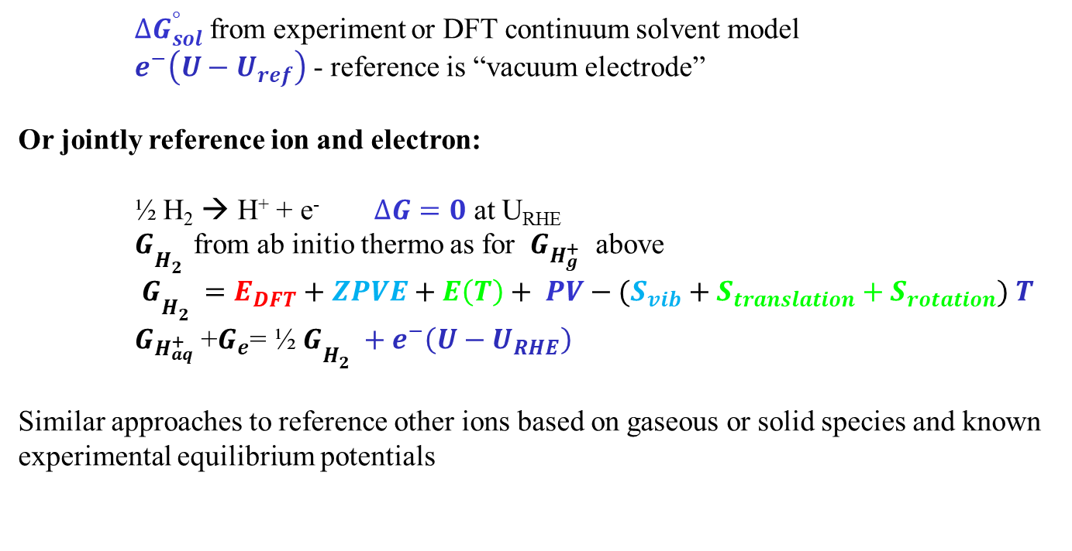
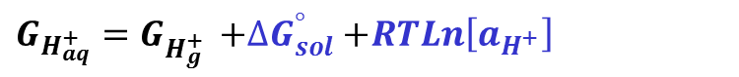
Choices to determine the chemical potential of the ion and electron
$$G_{H_{aq}^{+}}=G_{H_{g}^{+} }^{ }{+∆G}_{sol}^{°}+RTLn\left[a_{H^{+}}\right]$$
+
$$G_{H_{g}^{+}}^{ }=E_{DFT}+E\left(T\right)+ PV−{(S_{vib}+{S_{translation}+S}_{rotation})}_{ }T$$
${∆G}_{sol}^{°}$from experiment or DFT continuum solvent model
$e^{−}\left(U−U_{ref}\right)$ - reference is “vacuum electrode”
Or jointly reference ion and electron:
½ H₂ → H⁺ + e⁻ $∆G=0$ at U_{RHE}
$G_{H_{2}^{} }^{ }$from ab initio thermo as for $G_{H_{g}^{+}}^{ }$ above
$G_{H_{2}^{}}^{ }=E_{DFT}+ZPVE+E\left(T\right)+ PV−{(S_{vib}+{S_{translation}+S}_{rotation})}_{ }T$
$G_{H_{aq}^{+}}$ +$G_{e}$= ½ $G_{H_{2}^{}}^{ }{ + e}^{−}\left(U−U_{RHE}\right)$
Similar approaches to reference other ions based on gaseous or solid species and known experimental equilibrium potentials
DFT
DFT_{VIB}
Stat Mech
Expt/Set

Slide 14
Electrochemical reaction mechanisms – ion transfer and chemical steps:
Hydrogen oxidation (anode of a hydrogen fuel cell) [this not only possible mechanism]
H₂ + * → H₂* (calculate adsorption energy same as yesterday, no electrochem)
H₂* → 2H* (calculate reaction energy same as we discussed yesterday, barrier as desired)
H* → H⁺ + e⁻ + * (this is the reverse (negative) of what we just did)
ΔG_{rxn}(U_{CHE}) = - [G_{H*} - G* - ½ G_{H2,gas}+ +|e⁻|U_{CHE}]
Oxygen reduction (the cathode of a hydrogen fuel cell) [not the only possible mechanism]
O₂ + * → O₂* (Chemical)
O₂* → 2O* (Chemical)
O* + H⁺ + e⁻ → OH* (Electrochem) ΔG_{rxn}(U_{CHE}) = G_{OH*} - G_{O*} - ½ G_{H2,gas}+ +|e⁻|U_{CHE}
OH* + H⁺ + e⁻ → H₂O* (Electrochem) ΔG_{rxn}(U_{CHE}) = G_{H2O*} - G_{OH*} - ½ G_{H2,gas}+ +|e⁻|U_{CHE}
H₂O* → H₂O + * (Chemical)
Note the only difference versus the “adsorption” energy we calculated previously is that the proton/electron “adsorb” to an O* (ie, a surface that already has O on it) rather than a bare surface (*)

Slide 15
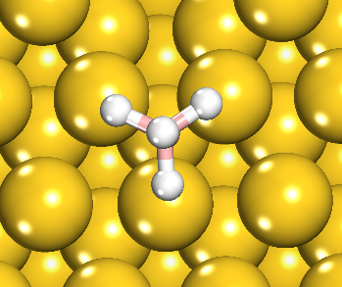
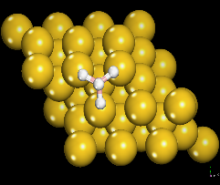
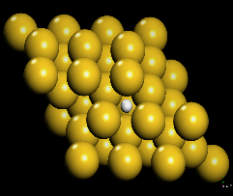
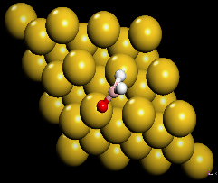
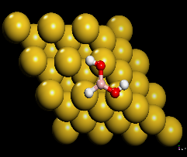
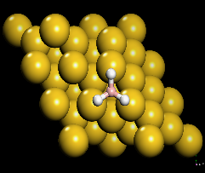
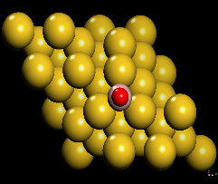
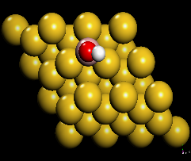
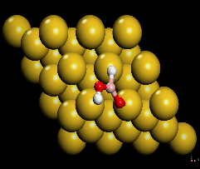
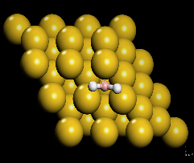
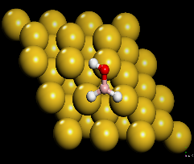
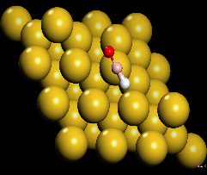
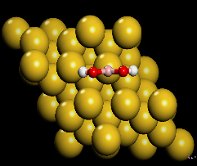
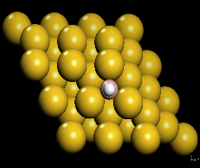
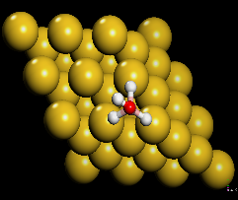
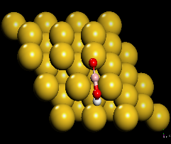
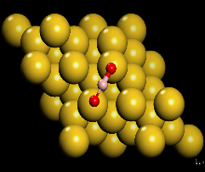
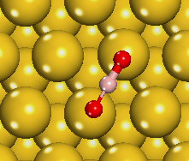

Reaction Intermediates and Adsorption Sites
BH₄* (+8OH⁻)
BH₄*
H*
BH₂O*
BH(OH)₂*
BH₃*
BO*
BOH*
BHOOH*
BH₂*
BH₂OH*
BHO*
B(OH)₂*
BH*
BH₃OH*
BOOH*
BO₂*
BO₂*
(+6H₂O+8e⁻)
Assumption – all adsorbates can access there most stable configuration

Slide 16
Minimum Energy Path over Au(111)
1.0
BO₂*
BH₄*
BH₃*
BH₄⁻ (aq)
BH₂*
0.0
BH₄*
BH₂OH *
BHOH*
BOOH*
BH(OH)₂*
B(OH)₂*
-1.0
BH₃*
U= -1.0 V (CHE)
BH₂*
Examples
BH₄* → BH₃* + H⁺ + e⁻
BH₂* + H₂O → BH₂OH* + H⁺ + e⁻
DFT same surface + ads
“Energy workup” now U dependent
-2.0
-3.0
Relative energy (eV)
BH₂OH*
U= -0.2 V (CHE)
-4.0
BHOH*
-5.0
BH(OH)₂*
-6.0
B(OH)₂*
BOOH*
BO₂*
-7.0
Borohydride oxidation

Slide 17




BUT – the reaction does not occur at a solid-gas interface, it occurs as a solid-electrolyte (ie, water with ions in our example)
+
+
e⁻
+
$${∆G}_{ads}= \sum{G_{products}−}\sum{G_{reactants}}$$
DFT
$${∆G}_{ads}\left(U\right)=G_{H∗}−G_{H_{\left(aq\right)}^{+}}−G_{∗}−e^{−}\left(U−U_{ref}\right)$$
DFT_{VIB}
Stat Mech
Expt/Set
$$G_{H_{aq}^{+}}=G_{H_{g}^{+} }^{ }{+∆G}_{sol}^{°}+RTLn\left[H^{+}\right]$$
Or reference through H₂ gas and U_{RHE}
$$G_{H_{g}^{+}}^{ }=E_{DFT}+E\left(T\right)+ PV−{(S_{vib}+{S_{translation}+S}_{rotation})}_{ }T$$
$$G_{∗}=E_{DFT}$$
$$G_{H^{∗}}=E_{DFT}+ZPVE−S_{vib}T$$
Adsorbate on Pt(111)
${∆G}_{ads}\left(U_{0}\right)=0 →$equilibrium potential U₀
(+q)

Slide 18
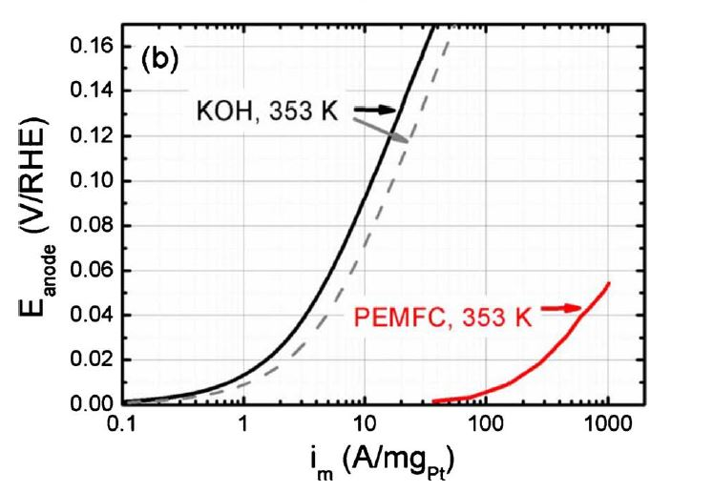
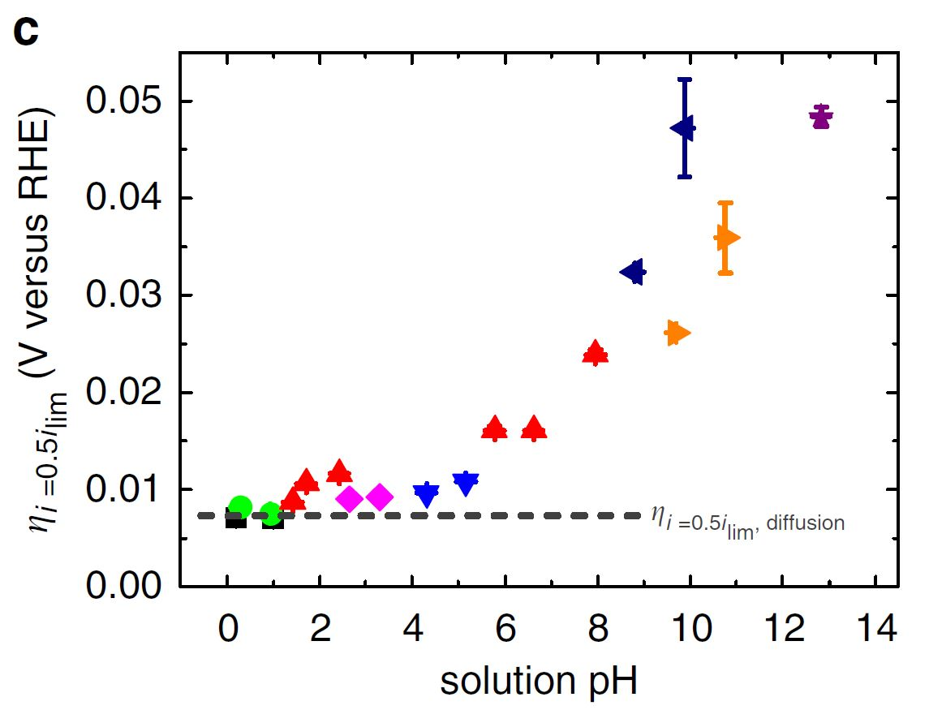
Both electrode and electrolyte impact electrocatalytic rates: pH on HOR
Overpotential V_{RHE}
W. Sheng, H.A. Gasteiger, Y. Shao-Horn. J. Echem. Soc., 157 B1529 (2010)
W. Sheng, Z. Zhuang, M. Gao, J. Zheng, J.G. Chen, Y. Yan Nature Communications 6 (2015).
Notes:
As you go to higher pH, and therefore lower absolute potential, you are making alkali cation adsorption, a reduction process, more favorable, relative to H/OH

Slide 19
Ions in electrolyte alter CO₂ RR activity and selectivity
Collaboration with Beatriz Roldan-Cuenya’s group, Fritz-Haber Institute
ACS Catalysis 8 (2018) 10012-10020

Slide 20
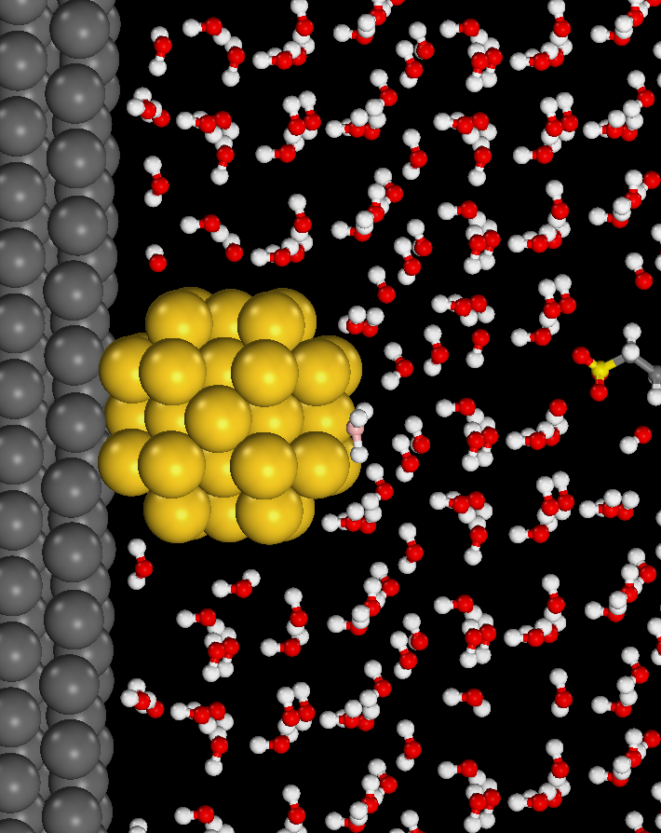
DFT representation of the complex electrochemical interface is challenging
e-
Anion exchange membrane
Fuel
Anode
Cathode
OH⁻
Composition
Structure
T,C,U
Activity
Selectivity
Stability
Electrocatalytic energetics affected by:
Electrolyte Structure (Solvation)
Electrode potential and electric field
Electron and ion reactant energies
Fuel Efficiency
Power Density
Catalyst Utilization

Slide 21
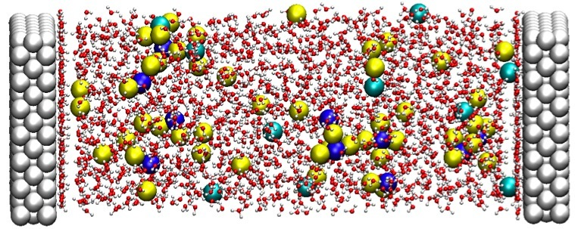

The electrolyte (solvent, counterions) structure varies on length and time scales beyond DFT simulations
Image from Madden and Chandler, Berkeley
1 M KOH = 1800 H₂O per 32 ion pairs
0.03 M KOH = 11000 H₂O per 6 ion pairs
Water relaxation times on the order of 10 ps, ion diffusion/dissociation much longer
How to charge surface, periodic charges, etc..
Notes:
MD approaches

Slide 22
DFT electrocatalysis models make approximations
No model is “right”
Image from Madden and Chandler, Berkeley
1 M KOH = 1800 H₂O per 32 ion pairs
0.03 M KOH = 11000 H₂O per 6 ion pairs
Water relaxation times on the order of 10 ps, ion diffusion/dissociation much longer
How to charge surface, periodic charges, etc..
Notes:
ADD PICTURES THEN FLASH TO TEXT OVER THE PICTURES

Slide 23
Ab initio MD does not provide a viable solution to handle electrochemical interfacial length and time scales
Time for a 15 ps MD simulation with 1 ion and 1 nm water layer
days
mol/L ion
Approximate wall time for a 15 ps AIMD simulation on 32 cores, including 4 water bilayers (1 nm) and 1 ion
Any DFT model of electrode/electrolyte interface will be approximate
Accurate enough to answer/inform research questions
Tested for sensitivity versus model choices
Notes:
MD approaches

Slide 24
Ion adsorption free energies are calculated using a combination of DFT calculations, statistical mechanics, and experimental data
+
+
e⁻
+
$${∆G}_{ads}= \sum{G_{products}−}\sum{G_{reactants}}$$
DFT
$${∆G}_{ads}\left(U\right)=G_{H∗}−G_{H_{\left(aq\right)}^{+}}−G_{∗}−e^{−}\left(U−U_{ref}\right)$$
DFT_{VIB}
Stat Mech
Expt/Set
$$G_{H_{aq}^{+}}=G_{H_{g}^{+} }^{ }{+∆G}_{sol}^{°}+RTLn\left[H^{+}\right]$$
Or reference through H₂ gas and U_{RHE}
$$G_{H_{g}^{+}}^{ }=E_{DFT}+ZPVE+E\left(T\right)+ PV−{(S_{vib}+{S_{translation}+S}_{rotation})}_{ }T$$
$$G_{∗}=E_{DFT}$$
$$G_{H^{∗}}=E_{DFT}+ZPVE−S_{vib}T$$
Adsorbate on Pt(111)
${∆G}_{ads}\left(U_{0}\right)=0 →$equilibrium potential U₀
(+q)

Slide 25
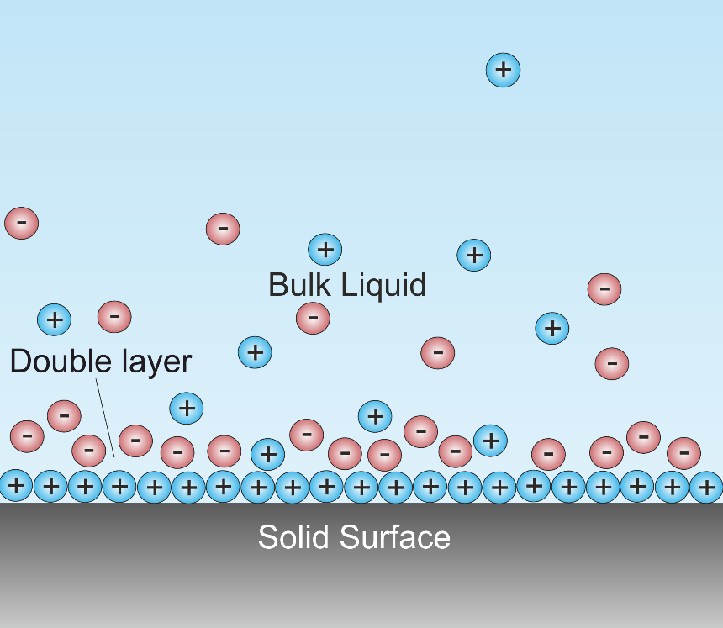
How to include the electrochemical interface in the model?
Choice 1 - ignore electrochemical interface entirely – use vacuum
Choice 2 – add solvation, ignore electrification
Choice 3 – add electrification through external field, ignore solvation
Choice 4 – add coupled solvation and electrificiation
For all of these, we can try putting the feature in the DFT model, or use an “analytical” model
to include the interaction of the electronic system with solvent/electrification “post-hoc”
Adsorbate on Pt(111)
(+q)

Slide 26
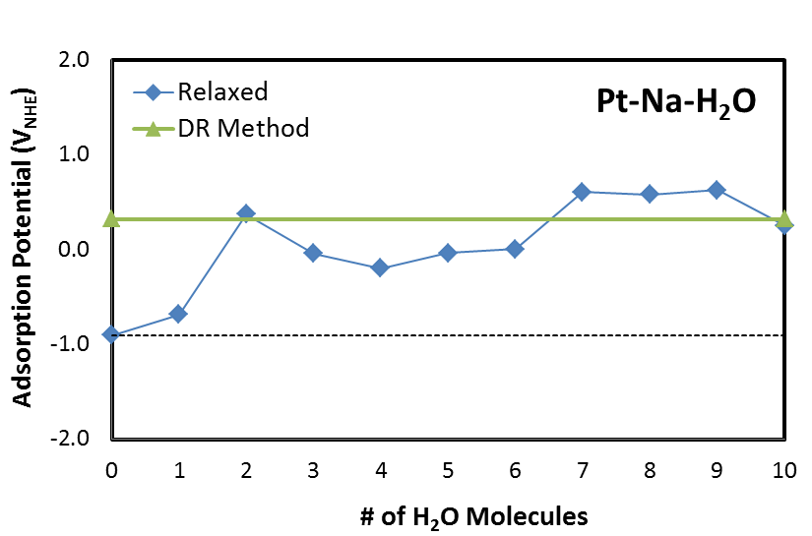
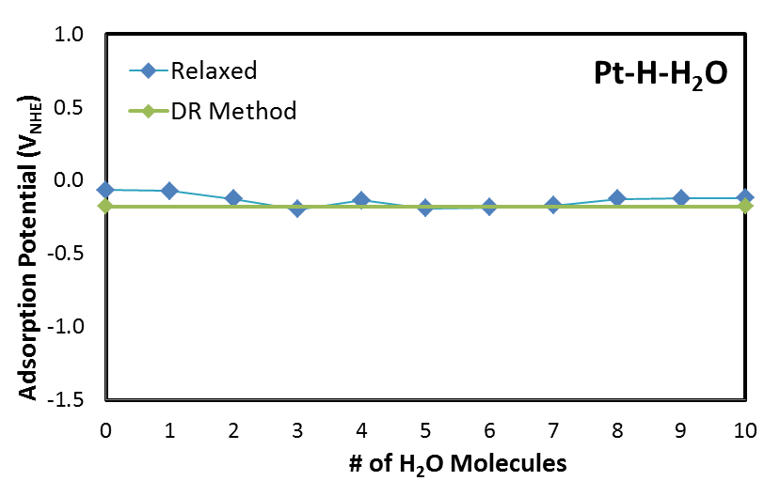
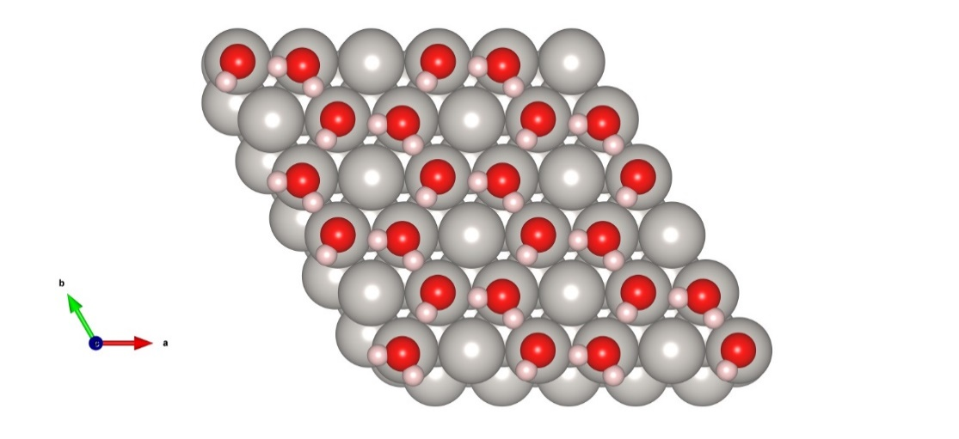
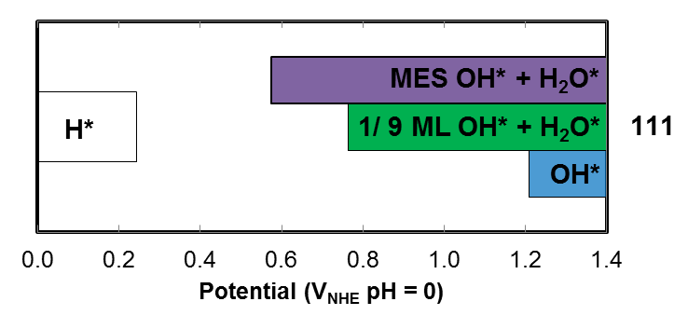
Solvation modeled through explicit H₂O molecules
> 1 eV
Dipole Moment (eÅ)
H* | -0.016
Na* | -0.83
OH* | 0.052
0.6 eV
Large dipoles, propensity for specific solvation dictate solvent inclusion
Solvation can vary from inconsequential to a 1 eV choice
Goal is to get “relative solvation energy” between initial, transition, final states
J.N. Mills, I.T. McCrum, M.J. Janik. Phys. Chem. Chem. Phys.. (2014)

Slide 27
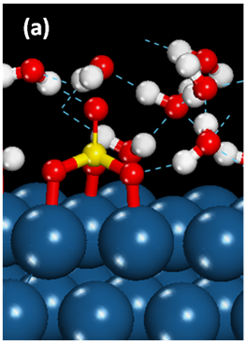
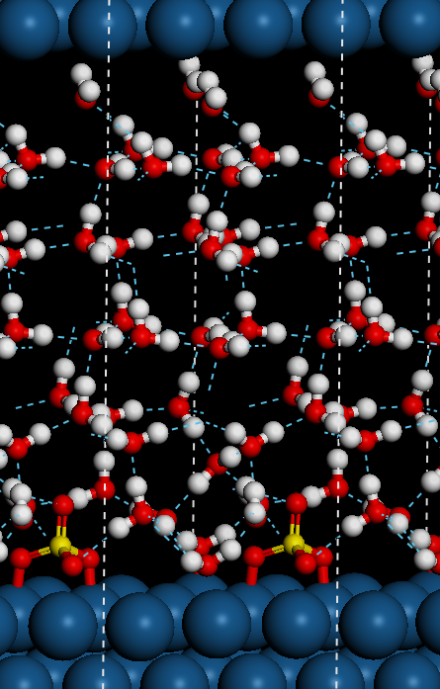
All solvent models have their pros and cons, and inherent imperfections will limit absolute accuracy
Micro-solvation
Fully explicit solvation
Continuum solvation
8H₂O + SO₄
Pros:
-Can capture differences in strong hydrogen bonds
-Computationally facile
Cons:
-Water structure unrestricted in density (surface normal)
Referencing between structures challenging
Static, local minima
(+q)
Pros:
-Not “static” (averaged), not only local
Cons:
-requires parameterization
-specific solvation dilemma
Pros:
-Can vary density
Cons:
-Computationally more intense
-Still a local minima (ice-like) and now there are more minima
R. Jinnouchi and A. B. Anderson
Phys. Rev. B77, 2454170-24541718 (2008)
Dabo (Penn State)
Arias (Cornell)
Sundararaman (RPI)

Slide 28
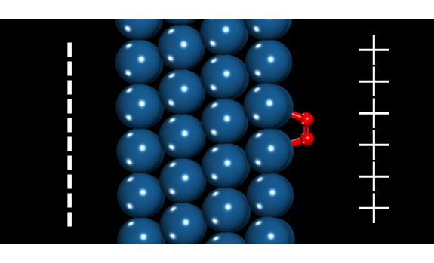
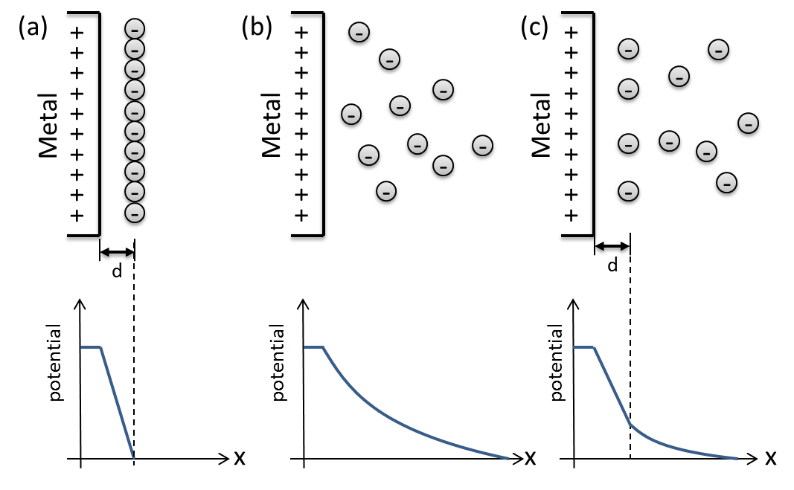
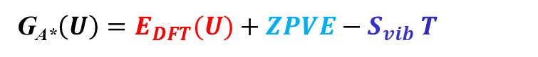
DFT Models can capture electrification of the electrocatalytic interface
Post-hoc electric field:
G_{A*}$\left(U\right)=E_{DFT}+ZPVE−{S_{vib}}_{ }T+μ_{A∗}E_{field}\left(U\right)$
$E_{field}\left(U\right)=\frac{U−U_{PZC}}{d}$ or from non-Helmholtz model
Pros: Picks up leading term of adsorbate/field interaction
Cons: Need field versus potential model
No adsorbate polarizability
Applied electric field:
G_{A*}$\left(E_{field}\right)=E_{DFT}(E_{field})+ZPVE−{S_{vib}}_{ }T$
$E_{field}\left(U\right)=\frac{U−U_{PZC}}{d}$ or from non-Helmholtz model
Pros: Adds polarizability
Cons: Now need a series of optimizations for each A*
Continuum Poisson-Boltzmann Ion Distribution:
G_{A*}$\left(U\right)=E_{DFT}(U)+ZPVE−{S_{vib}}_{ }T$
Pros: More physical ion distribution
Cons: Still a continuum approximation
Explicit/continuum dilemma
Anderson, Goddard, Marzari/Dabo, VASPsol

Slide 29
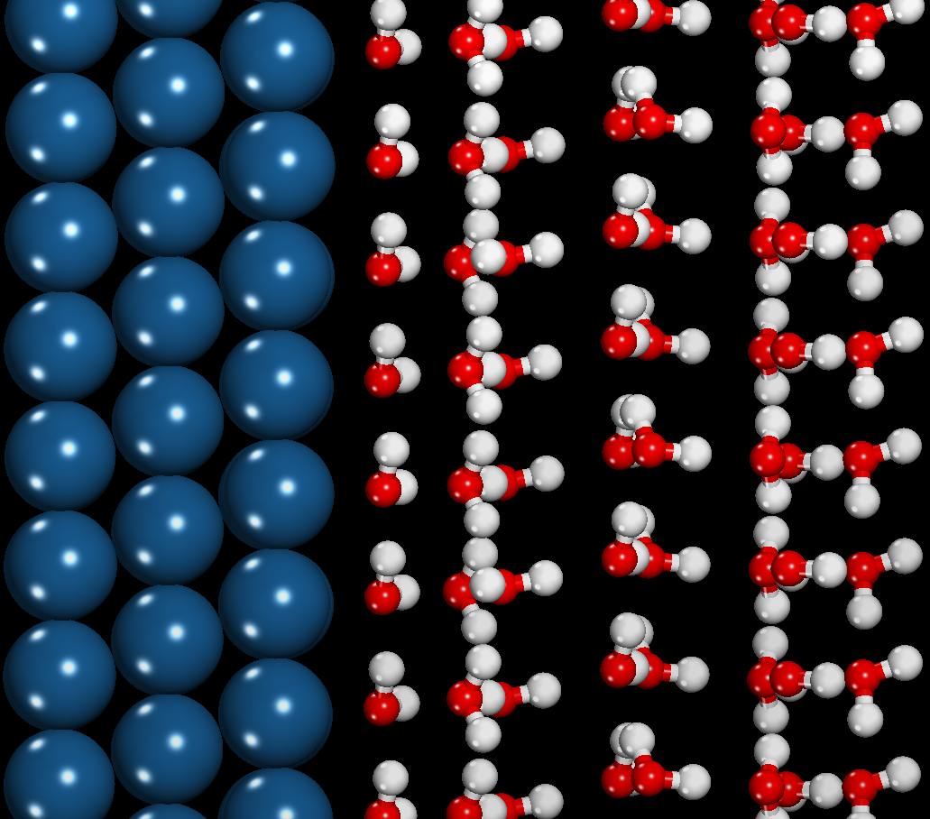
Double-Reference Method: include explicit charge and counter-charge in the unit cell
Electrode
Inner Layer
Quantum Chemical “Potentiostat”
–
+
Potential
Change # electrons (q):
-charges metal, shifts E_{F}
-countercharge added
-potential drop across interface
-vary q, tune potential
The subtle details:
Referencing the potential
Deriving proper energy
J. S. Filhol and M. Neurock Angew. Chem. Int. Ed. 45 (2006) 402.
C. D. Taylor et al. Phys. Rev. B 73 (2006) 165402.
Net Charge of q e
Net Charge of +q e
Notes:
Describe the actual electrochemical doublelayer region for non adsorbing electrolyte. Inner layer of water molecules polarized, net effect is a linear potential drop across this layer (time averaged water orientation leads to this, our single orientation wont).

Slide 30
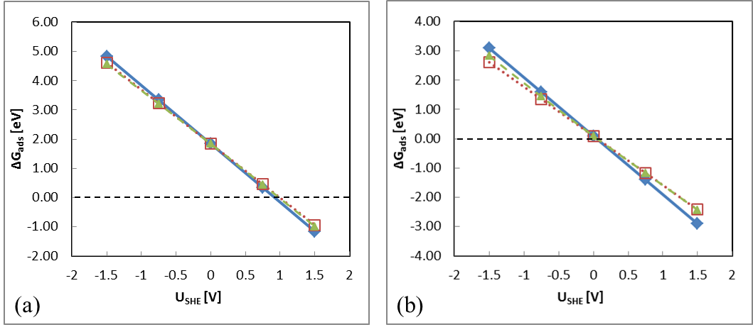
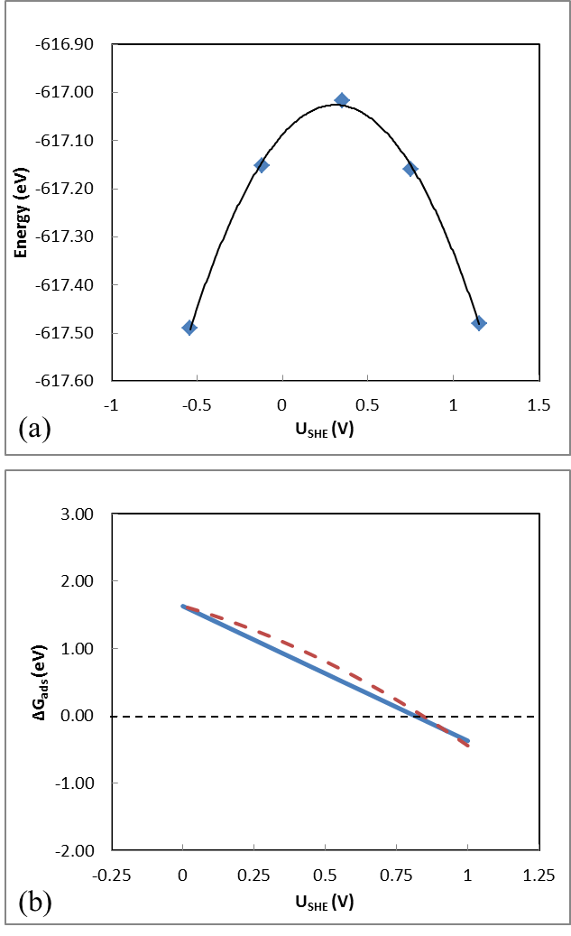
An “electrified interface model” gives minor differences in sulfate adsorption behavior (will be more significant for cations that retain charge)
No solvation
Micro-solvated
(+q)
Double-reference method
Solvation:
– shifts adsorption potential by >0.1 eV
Electrification:
– shifts adsorption potential by <0.05 eV
Notes:
Figure 8 The adsorption energy of sulfate anion over Pt(111) at (a) vacuum and (b) partially solvated interfaces. The diamond (◆) with solid line represents results from the linear free energy model (Model 2a.1), square with dotted line represents (□) the linear free energy model with dipole correction (Model 2a.2), and triangle (▲) with dashed line represents electric field model (Model 2a.3).
Figure 10 (a) The energy calculated with the double reference method using Equation 33. Points are for system charges of -1, -0.5, 0, 0.5, and 1 e⁻ in a Pt(111) 3x3 unit cell of 24H₂O*. Solid lines indicate the quadratic fit curves. (b) Calculated reaction energies for sulfate adsorption using the linear free energy method (thick-solid line) and the double reference method (dashed line).

Slide 31
Experimental cyclic voltammogram examines H/OH adsorption/desorption from Pt surfaces
Cyclic voltammetry of a polycrystalline platinum electrode
“H region”
O/OH/PtO_{x} region
Pt(110)
Pt(100)
Pt(111) [broad]
H* → H⁺ + e⁻ + *
H⁺ + e⁻ + * → H*

Slide 32
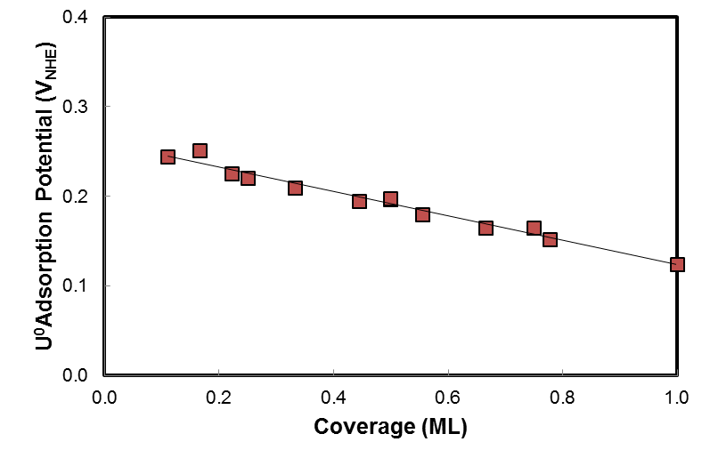
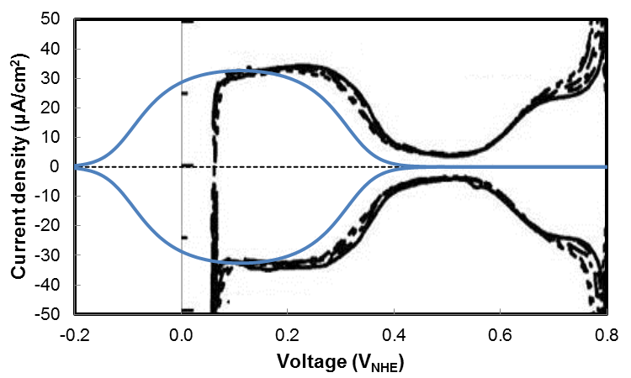
Vacuum interface model DFT for H*→H⁺ + e⁻ on Pt(111) matches experiment
Pt(111)
H* adsorption on Pt(111)
- coverage dependent
~ no surface dipole (0.0008 e⁻ Å)
DFT
EXPT on 111
Simulated CV matches experiment
-breadth
-height
-location
Experimental data is CV on Pt(111) at 50 mV/s in 0.1 M perchloric acid from V. Climent, R. Gómez, J. Orts, J.M. Feliu. J. Phys. Chem. B 2006, 110, 11344-11351
I.T. McCrum, M.J. Janik, J.Phys.Chem. C, 120, 457-471 (2016).

Slide 33
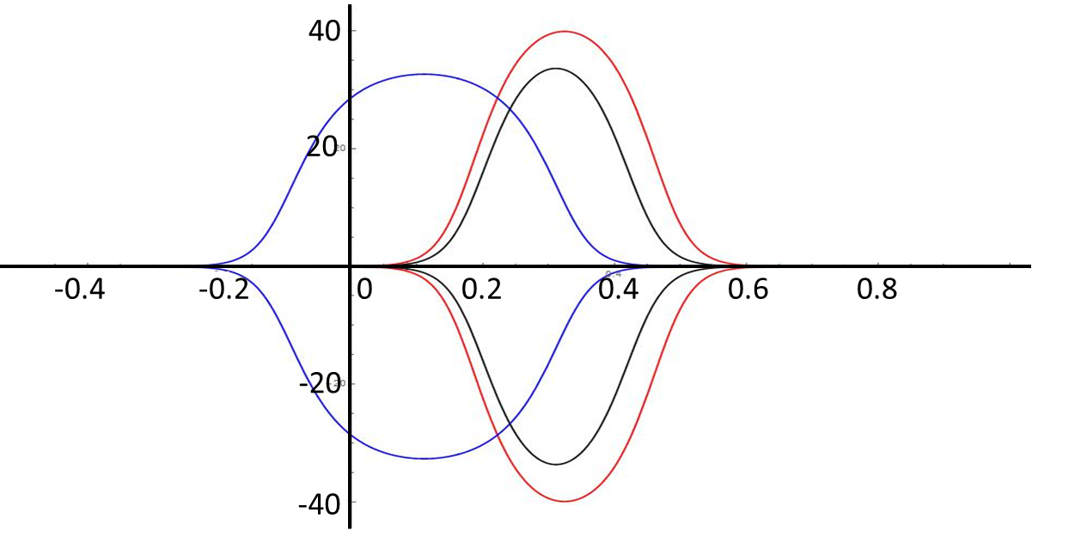
Peak order based on H* desorption does not match experiment
Pt(110)
Pt(100)
(110)
Pt(111)
(100)
(111)
Simulated cyclic voltammogram
111 coverage dependence explains broader peak
Simulation – 111 desorption before 110 and 100
Experiment – 110 and 111 before 100
Pt(111)
Pt(100)
Pt(110)
Current density (μA/cm²)
I.T. McCrum, M.J. Janik, J.Phys.Chem. C, 120, 457-471 (2016).
Potential (V_{RHE})

Slide 34





Pt(110) and Pt(100) peaks represent an H* to OH* exchange reaction
110
110
H*
OH*
100
111
111
110 and 100 peaks involve
exchange reaction
H* + OH⁻_{aq} → OH* + H⁺_{aq} + 2e
Pushes 110 peak to left, agrees with experimental peak order
100
N. Garcia-Araez, V. Climent, J.M. Feliu, J. Electroanal. Chem. 649 69 (2010).

Slide 35



K* specific adsorption at low coverage occurs in H* potential range
K* adsorption on Pt(111)
- extreme coverage dependence
~ large surface dipole (-1.06 e⁻ Å)
DFT H*
DFT K*
DFT H*
EXPT on 111
K peak (in H* absence) broad
Low coverage K* present in H* region
DFT K*
V_{NHE}
H*
K*
pH

Slide 36


Experiment – 110 and 100 peaks shift right in base
DFT – alkali “steals the solvation shell” making OH* adsorption less favorable
OH*
110
111
OH* with Na
H*
100
111
553 with “110” steps
533 with “100” steps
M. J.T.C. van der Niet, N. Garcia-Araez, J. Hernández, J.M. Feliu, M. T.M. Koper, Catalysis Today, 202, 105 (2013).

Slide 37

H* on the terrace and H*/(OH*+H₂O*) on the step simulated CV’s match experiment
Pt(553) with 110 steps and 111 terraces
0.1 M HClO₄ EXP
0.05 M NaOH EXP
M. J.T.C. van der Niet, N. Garcia-Araez, J. Hernández, J.M. Feliu, M. T.M. Koper, Catalysis Today, 202, 105 (2013).

Slide 38

H* on the terrace and H*/(OH*+H₂O*) on the step simulated CV’s match experiment
Pt(553) with 110 steps and 111 terraces
0.1 M HClO₄ EXP
0.1 M HClO₄ DFT
0.05 M NaOH EXP
I. T. McCrum, M. J. Janik ChemElectroChem 3, 1609-1617 (2016).
M. J.T.C. van der Niet, N. Garcia-Araez, J. Hernández, J.M. Feliu, M. T.M. Koper, Catalysis Today, 202, 105 (2013).

Slide 39

H* on the terrace and H*/(OH*+H₂O*) on the step simulated CV’s match experiment
Pt(553)
0.1 M HClO₄ EXP
0.1 M HClO₄ DFT
0.05 M NaOH EXP
0.05 M NaOH DFT
I. T. McCrum, M. J. Janik ChemElectroChem 3, 1609-1617 (2016).
M. J.T.C. van der Niet, N. Garcia-Araez, J. Hernández, J.M. Feliu, M. T.M. Koper, Catalysis Today, 202, 105 (2013).

